Slide 1
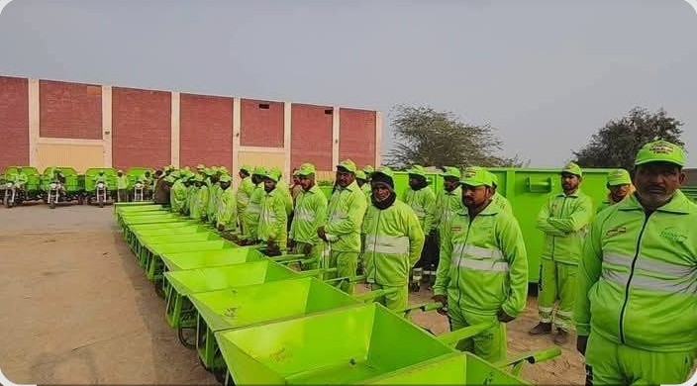

HOSPITAL INFECTION CONTROL & SAFETY
Stay Clean, Stay Safe
Personal hygiene and infection prevention training for sanitary workers
Anila Munir, PharmD
Clinical and Community Pharmacist
Training Initiative for 100 Sanitary Workers | DAAD EPOS Application

Slide 2



OCCUPATIONAL SAFETY
Why Your Health Matters
Risky Bio-Medical Waste
Blood-soakeditems,soiledlinens,and body fluids harbor dangerous pathogens.
Hidden Sharps Hazards
Needles,scalpelblades,andglass hide inside routine trash bags.
Community Protection
Cleanhabitsbreaktransmissionchains, keeping your family and patients safe.

Slide 3


MICROBIOLOGY BASICS
What Is an Infection?
The Invisible Threat
Germsenterthebodyandmultiply rapidly. Because they are microscopic, we must assume dirty surfaces always
carry pathogens.
Common Pathogens
Resulting Health Risks
Bacteria, viruses, and fungi cause clinical illness.
Diarrhoea, skin infections, blood-borne hepatitis, and severe fever.

Slide 4

TRANSMISSION ROUTES
4 Key Entry Pathways Into Your Body
1. Facial Contact
2. Open Wounds
3. Sharps Pricks
4. Fluid Splashes
Dirty hands touching mouth, nose, or eyes.
Germsinvading uncovered cuts or scratches.
Direct needlepunctures during bag handling.
Chemical orliquid
splashes reaching eyes or mouth.

Slide 5


CORE HYGIENE TECHNIQUE
6-Step Handwashing Protocol
1
Wet & Soap: Apply sufficient soap with clean running water.
2
Rub Palms: Palm to palm in thorough circular motions.
3
Backs & Interlace: Rub back of hands and between fingers.
4
Thumbs & Nails: Rotational scrubbing of thumbs and fingertips.
5
Wash Wrists: Clean wrist area thoroughly.
6
Rinse & Dry: Rinse fully and dry with single-use towel.
Wash for at least 20 seconds

Slide 6


PERSONAL PROTECTION
PPE Gear & Correct Removal Sequence
Essential Equipment
Removal (Doffing) Order
Gloves: Protecthands fromfluids.
1. Gloves: Remove first;most contaminated.
Mask & Goggles: Block airborne dust & splashes. Boots & Apron: Shield feet & clothing from spills.
2. Apron: Peel down away from neck and shoulders. 3. Goggles: Handle only by headband.
4. Mask: Untie or remove ear loops cleanly.
5. Immediate Hand Hygiene: Wash with soap immediately.

Slide 7

DAILY HABITS
Personal Cleanliness Rules
Clean Attire
Bathe daily and wear a clean uniform on every shift.
Nail & Wound Care
Vaccinations
Keep nailstrimmed short.Cover cuts with waterproof bandages.
Maintain activeHepatitis B and
Tetanus immunizations.
Strictly prohibited in waste handling areas: Zero eating, drinking, or smoking.

Slide 8



PHARMACIST PRACTICAL GUIDANCE
Alcohol Hand Sanitizer Protocol
Formulation Requirements
Visible Dirt Warning
Requiresatleast60%alcoholcontent. Keep away from
Sanitizer cannot cleanvisiblydirty or greasy hands. Wash with soap first!
heat sources.
3-Step Application Method
Step 1: Dispensea cupped palmfulof product.
Step 2: Rub palms, backs, interlaces, and fingertips thoroughly. Step 3: Rub for 20 seconds until completely dry. Do not wipe.

Slide 9




WASTE MANAGEMENT
Color-Coded Segregation System
YELLOW BIN
BLACK BIN
Infectiouswaste,dressings, blood items.
Generalnon-risktrash, food, paper.
RED SHARPS BOX
SPECIAL BOX
Puncture-proofforneedles,blades, glass.
Chemicals&expiredpharmacy stock.

Slide 10


BEST PRACTICES
Safe Waste Handling: DO vs. NEVER
ALWAYS DO
NEVER DO
• Seal bags when3/4 full.
• Press trashdown with hands or feet.
• Carry bags by neck, away from body.
• Bend or recap used needles.
• Transport using dedicated waste trolleys.
• Sort waste with bare hands.
• Report spills immediately.
• Carry loose sharps in hands.

Slide 11




EMERGENCY FIRST AID
Needle-Stick & Splash Protocol
Step 1: Do Not Squeeze
Allow woundto bleed gently naturally. Do not scrub hard.
Step 2: Immediate Wash
Wash with soap under running water. Rinse eyes with clean water.
Step 3: Report Incident
Step 4: Seek Care Today
Notifysupervisor and infection control lead immediately.
Earlyprophylaxis
treatment prevents infection.
Reporting injuries protects you, your family, and your rights!

Slide 12



EDUCATIONAL SCOPE
Public Health Training Outreach
100
Small Interactive Cohorts
Taughtinpracticalgroupsof25for active hands-on coaching.
Practical Demonstrations
Livehandwashingdrills,PPEdonning, and sanitizer distribution.
Follow-Up Audits
Monthlyrefreshertalksand safety checklists.

Slide 13

ACADEMIC VISION & FUTURE IMPACT
DAAD EPOS Global Health Commitment
LEARN
Master Global Health
Deepen expertise in advanced infection prevention and public health programs.
APPLY
Train-the-Trainer
Empower supervisors to expand hygiene training across regional hospitals.
SUSTAIN
Systemic Improvement
Implement standardized safety protocols across community health systems in Pakistan.
"A training starting with 100 workers can protect thousands of lives."

Slide 14

CORE TAKEAWAYS
4 Golden Rules of Sanitation
REPORT
WASH
PROTECT
SEPARATE
Your health protects your family, your patients, and your entire community.
Thank You!
Anila Munir, PharmD | Hospital Pharmacist

